Slide 1
< Presentation English speaking />
< name: Pepijn dik />
<class: Ao3b />
<end/>

Slide 2
What i would like to tell
Talk a lillte bit about my self
01
Where i have done my internship
02
What did i do there
04
About the company
03
My internship experience and opinion
05

Slide 3



About myself
Me?
School
Age
Living
Last Year
Education
Fav” school project

Slide 4

Where i have done my internship
Location: Voorschoten
Small vilage
More locations?

Slide 5




About the company
Web development
What they do there ->
Small company (6 p)
Who started
Hosting & Seo
Design & Desktoppublishing (DTP)
Printing

Slide 6
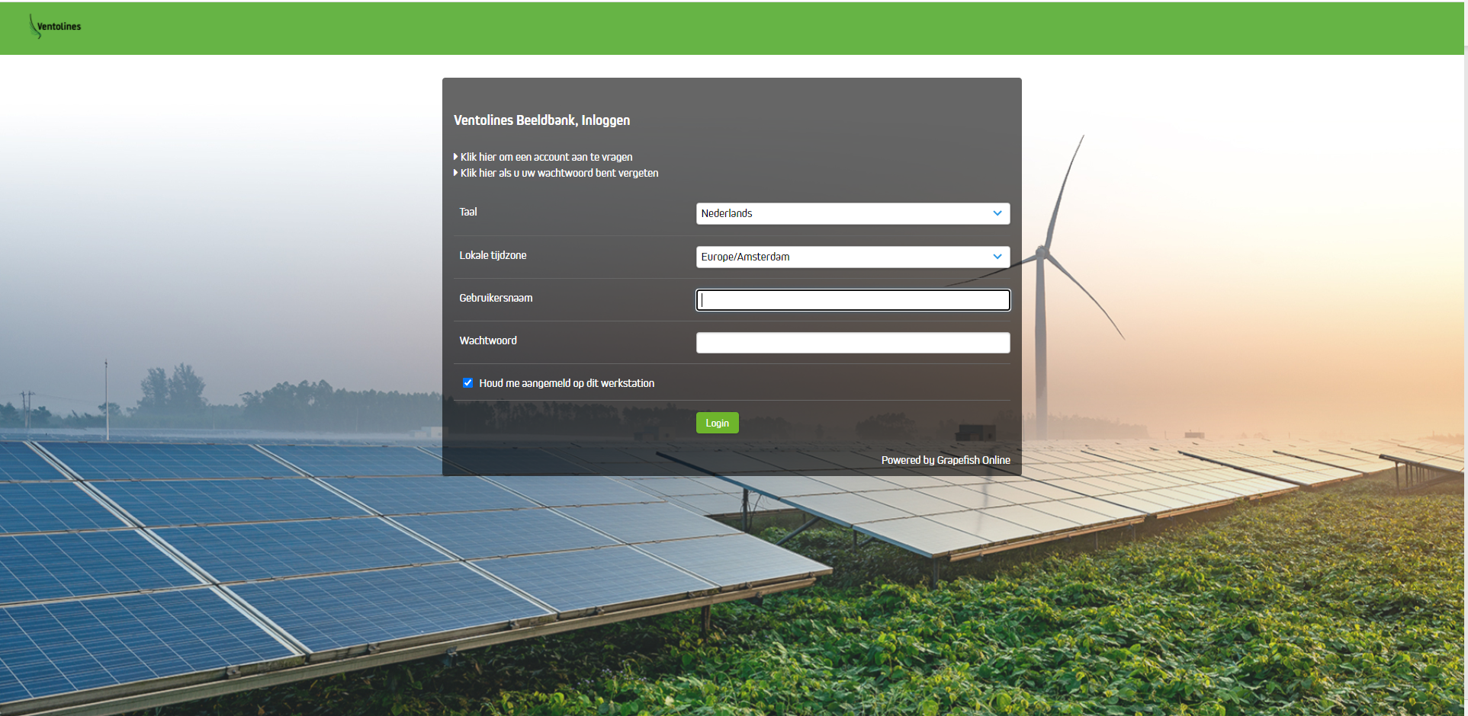
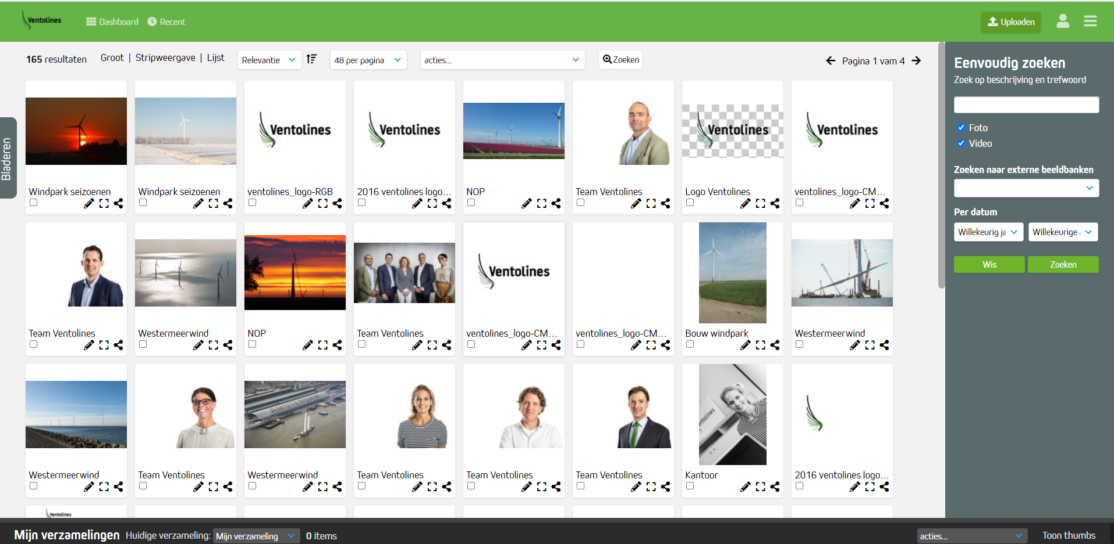
What did i do?
Internship
How long,
50 days,
Full time
One Programming project
Digital asset manager
What is it?
How did i do it?

Slide 7
My opinion about the internship
Nice people
Much self learing
Not enough help

Slide 8
The end
<php
If(end == true ) {
Echo “Thanks for listening
If there are any question?
Please let me know”
/>

